Slide 1
DS160 Crab Presentation
By Joey Guthrie

Slide 2
Hypothesis and Background
My hypothesis, and the motivating question for this project’s work, is “how are the size, age, and weight of crabs correlated with each other?” I was able to answer this question of course, but that will be discussed later in the presentation.
I chose the specific dataset I used from Kaggle because its subject matter relates to something I’ve always found fascinating; the dataset is about crabs, more specifically their age, and different components of weight and size. I have always found arthropods to be very cool creatures in general, and crustaceans, such as crabs, are no exception.
The code was done in Python, using Pandas, Numpy, Seaborn, Matplotlib, and Sklearn. I also used several of my class notebooks on these modules and linear regression for reference to help guide me in my work.

Slide 3
Dataset Info
The dataset has 3893 entries and 9 columns. The columns and their datatypes are shown in the following table:
Variable Name | Data Type
Sex | Object
Length | Float64
Diameter | Float64
Height | Float64
Weight | Float64
Shucked Weight | Float64
Viscera Weight | Float64
Shell Weight | Float64
Age | Int64

Slide 4
Data Cleaning/Preprocessing
Surprisingly enough, there was not a lot to do for data pre-processing before constructing my model. There were no null or invalid values, no outliers egregious enough to warrant removal, and overall, the dataset was already a very nicely polished and organized assortment of information.
For the preprocessing aspect before building the model, all I really did was cut the “Sex” column, because when I made a duplicate of the information in the column and assigned numerical values instead of strings of text, the results were not terribly interesting or noteworthy. Many of the crabs were of indeterminate sex too, and due to the variation in size regardless of age and sex, I determined that I would’ve been largely unable to accurately impute values for the indeterminate sex crabs.
I then split the data into training and test sets, with a distribution of 80/20.

Slide 5
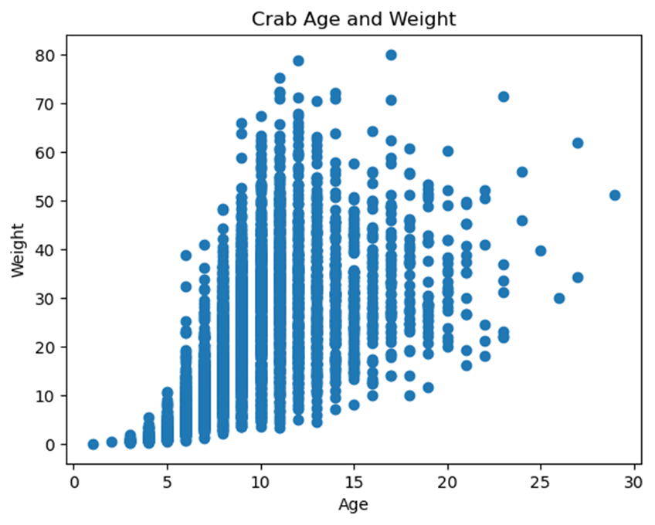
Correlation Between Weight and Age?
The graph opposite to this text is the most noteworthy and summarily representative of the results of my analysis.
Of particular note, is how thoroughly distributed the weight becomes as age increases. Using different bin sizes and tick amounts made the graph increasingly more chaotic to look at, so I settled for this, 8 ticks and a bin size of 5.

Slide 6
Correlation Between Weight and Age (continued)
As previously stated, I find the most interesting piece of information in the graph to be that the relationship with age and weight is not necessarily a linear one here; while larger sizes and weights are associated with higher ages, there is a great diversity in the weight and size of crabs. The maximum heights among each bin increase dramatically with age, while the minimum has a much less noticeable or nonexistant growth, largely regardless of age.
This has the very fascinating implication that among the populations of the crabs represented in the dataset, age doesn’t lead to an increase in weight and size as much as it leads to an increase in variability and spread of these traits. While younger crabs are more uniform in size, older crabs are pretty evenly distributed among almost all sizes previous represented, with the addition of higher weights appearing too.

Slide 7
Other Relevant Information:
Though I had made 9 more graphs looking for correlations between the variables, they largely only served to support the data found in the graph I’ve included in this presentation. The most drastic departure in shape, distribution and skew would be the correlations between weight and height, and height and age, wihtch remained relatively flat. The relationship between diameter, length, and weight is a much more traditional looking one, with the data points manifesting on the graph in a “half-parabola” shape that plateaus at the top.

Slide 8
My Model:
I used the Sklearn module to create a model with the data, based off of the models made in class notebooks. I decided to keep the 80/20 split between test and training data in order to give the model a much larger amount of data for training/learning. The results of trials determining the accuracy of my model in guessing weight from age and other factors was not terribly noteworthy in my opinion. Not to imply that the predictions were bad by any means, and they certainly improved with each trial, but ultimately they didn’t diverge much from what I came to expect. Aside from the first trial, the biggest gaps between the predicted and actual weight generally stayed below .2.

Slide 9
Table of Values from Trials
Test # | Predicted Value | Actual Value
1 | 25.96420046 | 24.635715
2 | 5.24713593 | 5.400580
3 | 7.78188847 | 7.952035
4 | 13.30178082 | 13.480187

Slide 10
Regrets:
Yes. Rather than title this slide about challenges and problems encountered with the code itself and the ways to improve from a coding standpoint, I named it “regrets” since most of the issues I encountered were unrelated to the coding aspect.
This project hasn’t been terribly smooth. Bogged down with finals, papers, and exams in other classes for the past month-and-a-half, dealing with burnout and anxiety, and staying focused on merely getting assignments done all contributed to difficulty in developing this project. I wish I could have made something more impressive and thorough, but as of the writing of this slide, I simply do not have time to do that and modify my programs.
While most of the contributing factors to the difficulties with this project were unavoidable, the most pervasive one with the biggest impact on my work in general is the last one listed. For a long time, I have worked by focusing on completing instructed criteria, and as a result, put almost all my effort into merely producing work that checks off requirements. Accordingly, as concepts being taught become increasingly complex, this emphasis on simply “getting things done, in any way I can” has left me less focused on actually learning and understanding concepts, and more focused on trying to follow instructed guidelines and desirable grades.

Slide 11
The Future and Changes Going Forward:
With this project, I have ironically learned more of my own faults in how I set and follow goals than I have learned about machine learning or linear/logistic regression. As such, rather than make up a response that I don’t entirely understand about how I will improve my coding, analysis, and model next time, the manner which I seek to improve is more personal.
While doing projects and assignments only for the sake of getting the work done has worked for much of my life, this strategy has demonstrated its heavy flaws over my time at Bellarmine so far. Thus, in order to improve my quality of work and mastery of concepts going forward, I will put more thought into learning about and thoroughly, critically understanding the actual concepts in my projects and assignments, rather than solely focus on the assignment’s completion. Tutoring, a shift in mindset, and messing around with coding in my free-time are all ways that I plan on achieving greater understanding and mastery of concepts moving forward.

Slide 12
Conclusion
I’m probably running short on time by the point when I’ve reached this final slide, but to sum up my project and findings, there is a positive correlation between age and maximum weight and size found within the age bins among the crabs in the dataset. My model was simple, predicted things with reasonable accuracy, and gave me answers for the project, but was ultimately just that. Not defective or glaringly inaccurate, but not innovative or expansive enough. Moving forward, to prevent relatively empty presentations like this one, I will make it an effort to actually learn something with each assignment, and would highly recommend others to do the same if they aren’t already.

Slide 13
Sources:
https://www.kaggle.com/datasets/sidhus/crab-age-prediction

Slide 14
Fin

